Slide 1
Introduction to
JavaScript
(.js)
JavaScript Tutorial by Manu E S
Easy Learning with .js “Enjoy The Course”

Slide 2
What is JavaScript ?
JavaScript is a powerful and flexible programming language. It can execute on a web browser that allows us to make interactive web pages such as popup menus, animations, form validation, etc.
JavaScript has evolved a lot in the past decade. Our JavaScript tutorial will help you understand the core concepts of modern JavaScript, one step at a time.

Slide 3
About JavaScript Programming
Prototype based Object-oriented - JavaScript is an object-oriented programming language. It used prototypes instead of classes. Objects are used to represent the real-world entity in the program.
Interpreted Language - JavaScript is an interpreted programming language. It uses just-in-time compilation technique at run-time.
Event-Based Programming - JavaScript allows us to write codes that are executed differently under different events.
Platform Independence - JavaScript codes are run on browsers. So irrespective of the machine, if the browser supports JavaScript, codes can run.

Slide 4
Why Learn JavaScript?
JavaScript is both client-side and server-side programming language. In the client-side, the code is run and displayed by the browser. On the server-side, Node.js is used.
JavaScript is a platform-independent language. Any browser supporting JavaScript can run the code irrespective of the operating system
JavaScript uses the just-in-time compilation technique. Since the compilation is handled at run time, JavaScript is considered an interpreted language.
JavaScript is a dynamically typed language. That is, a variable containing number may be reassigned to a string.

Slide 5
What are interactive web pages ?
An interactive webpage is essentially an Internet page that uses different kinds of software to create a rich, interactive experience for the user i.e. it facilitates the user to be actively engaged with the site. For e.g. Let's take the case of a website that displays weather forecasts for a specific region. If the website is interactive, it enables the user to type in his/her location and shows the detailed weather report for that region. The website may also display the weather forecasts for various countries across the globe and allows the user to zoom and focus on specific regions, or manipulate the globe to get a quick glimpse of the weather in different parts of the world.
Interactive websites allow users to change the way the website displays, play games, interact with friends online, and perform a host of tasks. This includes:
Online transactions
Submitting stories, photos, videos, and blogs
Interactive features, such as calculators and clickable maps, helps the user to explore the various services offered by a company
Personalization of content and experience based on history and demographics.
Features, such as live chat, pop-​​up and help screens enables context-sensitive, user-friendly help.

Slide 6
Advantages of JavaScript?
1. Speed
Since JavaScript is an ‘interpreted’ language, it reduces the time required by other programming languages like Java for compilation. JavaScript is also a client-side script, speeding up the execution of the program as it saves the time required to connect to the server.
2. Simplicity
JavaScript is easy to understand and learn. The structure is simple for the users as well as the developers. It is also very feasible to implement, saving developers a lot of money for developing dynamic content for the web.
3. Popularity
Since all modern browsers support JavaScript, it is seen almost everywhere. All the famous companies use JavaScript as a tool including Google, Amazon, PayPal, etc.

Slide 7
Advantages of JavaScript?
4. Interoperability
JavaScript works perfect with other programming languages and therefore numerous developers prefer it in developing many applications. We can embed it into any webpage or inside the script of another programming language.
5. Server Load
As JavaScript operates on the client-side, data validation is possible on the browser itself rather than sending it off to the server. In case of any discrepancy, the whole website needs not to be reloaded. The browser updates only the selected segment of the page.
6. Rich Interfaces
JavaScript provides various interfaces to developers for creating catchy webpages. Drag and drop components or sliders may give a rich interface to the webpages. This leads to improved user-interactivity on the webpage.

Slide 8
Advantages of JavaScript?
7. Extended Functionality
Third-party add-ons like Greasemonkey (a Mozilla Firefox extension) allow the developers to add snippets of predefined code in their code to save time and money. These add-ons help the developers build JavaScript applications a lot faster and with much more ease than other programming languages.
8. Versatility
JavaScript is now capable of front-end as well as back-end development. Back-end development uses NodeJS while many libraries help in front-end development like AngularJS, ReactJS, etc.
9. Less Overhead
JavaScript improves the performance of websites and web applications by reducing the code length. The codes contain less overhead with the use of various built-in functions for loops, DOM access, etc.

Slide 9
Disadvantages of JavaScript?
1. Client-side Security
Since the JavaScript code is viewable to the user, others may use it for malicious purposes. These practices may include using the source code without authentication. Also, it is very easy to place some code into the site that compromises the security of data over the website.
2. Browser Support
The browser interprets JavaScript differently in different browsers. Thus, the code must be run on various platforms before publishing. The older browsers don’t support some new functions and we need to check them as well.
3. Lack of Debugging Facility
Though some HTML editors support debugging, it is not as efficient as other editors like C/C++ editors. Also, as the browser doesn’t show any error, it is difficult for the developer to detect the problem.

Slide 10
Disadvantages of JavaScript?
4. Single Inheritance
JavaScript only supports single inheritance and not multiple inheritance. Some programs may require this object-oriented language characteristic.
5. Sluggish Bitwise Function
JavaScript stores a number as a 64-bit floating-point number and operators operate on 32-bit bitwise operands. Thus, JavaScript converts the number to 32-bits signed integers, operates on them and converts them back to 64-bits JavaScript numbers. This continuous conversion takes more time in conversion of number to an integer. This increases the time needed to run the script and reduces its speed.
6. Rendering Stopped
A single code error can stop the rendering of the entire JavaScript code on the website. To the user, it looks as if JavaScript was not present. However, the browsers are extremely tolerant of these errors.

Slide 11
How JavaScript Works?
The Runtime
The JavaScript Engine works inside an environment for additional features used at runtime. Although JavaScript is single-threaded, the runtime environment consists of a thread pool. It allows JavaScript to simultaneously run in the background while the user browses without interrupting the program flow.
Event Loop
This mechanism manages all the threads from the thread pool in the order of their execution i.e. it handles callbacks. A callback is a piece of code executed when a particular event i.e. mouse click occurs.
If an event occurs, the environment puts the callback in the Event Handler under the Event Loop. Callbacks are always executed one at a time.

Slide 12
How JavaScript Works?
JavaScript is single-threaded. This means that the instructions execute sequentially, one at a time. This is possible with the help of the following components:
The JavaScript Engine
It is a program responsible for the translation of source code into machine language and its execution on a CPU. Each modern browser comes with a JavaScript engine. Thus there is no need to download any extra software.
The engine consists of 2 components:
Memory Heap– Memory allocation takes place here.
Call Stack– When the script calls a function, the interpreter first adds it to the call stack and then starts processing it.
The most used JavaScript Engines include Chrome V8, Firefox’s SpiderMonkey, Safari’s Nitro and Edge’s Chakra.

Slide 13
Call Stack
A call stack is a mechanism for an interpreter (like the JavaScript interpreter in a web browser) to keep track of its place in a script that calls multiple functions — what function is currently being run and what functions are called from within that function, etc.
The call stack is primarily used for function invocation (call). Since the call stack is single, function(s) execution, is done, one at a time, from top to bottom. It means the call stack is synchronous.
Whenever a function is called, the JavaScript engine creates a Function Execution Context for the function, pushes it on top of the Call Stack, and starts executing the function.
If a function calls another function, the JavaScript engine creates a new Function Execution Context for the function that is being called and pushes it on top of the call stack.
When the current function completes, the JavaScript engine pops it off the call stack and resumes the execution where it left off in the last code listing.
The script will stop when the call stack is empty.

Slide 14
Memory allocation
Memory allocation is a process by which computer programs and services are assigned with physical or virtual memory space.
Memory Allocation: Memory allocation is a process by which computer programs and services are assigned with physical or virtual memory space. The memory allocation is done either before or at the time of program execution.
Memory allocation is the process of reserving a partial or complete portion of computer memory for the execution of programs and processes. Memory allocation is achieved through a process known as memory management.
Memory allocation is primarily a computer hardware operation but is managed through operating system and software applications. Memory allocation process is quite similar in physical and virtual memory management. Programs and services are assigned with a specific memory as per their requirements when they are executed. Once the program has finished its operation or is idle, the memory is released and allocated to another program or merged within the primary memory.
Memory allocation has two core types;
Static Memory Allocation: The program is allocated memory at compile time.
Dynamic Memory Allocation: The programs are allocated with memory at run time.

Slide 15
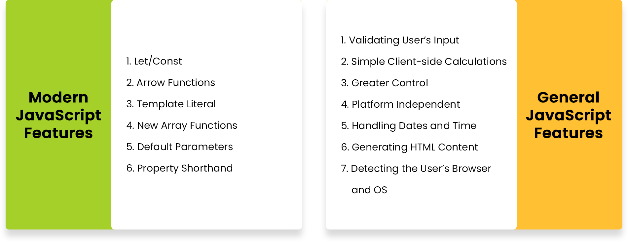
JavaScript Features

Slide 16
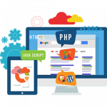

Applications of JavaScript
1. Web Development
Web Development is a standalone language for creating web pages. It also supports external applications like PDF documents, running widgets, etc. This also adds various special effects to the page like graphics.
2. Web Applications
A web application is a software or program which is accessible using any web browser. Developing your website helps you in branding your business.

Slide 17



Applications of JavaScript
3. Presentations
JavaScript provides user-friendly libraries and frameworks for presentations. It provides polished themes that are not too flashy.
4. Server Applications
Javascript is also very useful for building server applications and is faster than other server-side languages. NodeJS is an open-source and free server environment used to achieve this. It allows the generation of dynamic web content, modify a database, collect form data, etc.
5. Web Servers
NodeJS has a built-in module (a set of functions) that allows the creation of an HTTP server. Though starting as a client-side script, JavaScript is now fully capable of server-side scripting as well.

Slide 18


Applications of JavaScript
6. Games
Along with HTML5, JavaScript helps in game development. EaselJS library provides simple solutions for working with rich graphics. It also has a familiar API many developers prefer.
7. Art
Using JavaScript, drawing graphics with HTML has become easier in a web page. A canvas is present without any border or content so that the users can create their own art. It has equipped the user with a medium for different digital art projects.

Slide 19
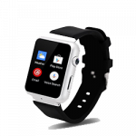


Applications of JavaScript
Smartwatch Applications
JavaScript contains a library PebbleJS which provides simple solutions for working with rich graphics. The developer has access to many features for the application built for smartwatches.
Mobile Applications
JavaScript provides a framework called PhoneGap that supports mobile applications. React Native is also serving the same purpose these days. With a decent knowledge of HTML, CSS, and JavaScript, we can build wonderful applications.
Machine Learning
Javascript has introduced machine learning along with all the previous features. Various frameworks like Keras.js, BrainJS, Compromise, and WebDNN improve the functionality of JavaScript in the field of AI.

Slide 20
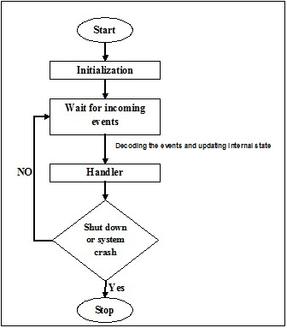
What is Event-Based Programming?
Simply put, event-based programming or event-driven programming is when a program is designed to respond to user engagement in various forms. It is known as a programming paradigm in which the flow of program execution is determined by “events.” Events are any user interaction, such as a click or key press, in response to prompt from the system. To visualize event programming more clearly, imagine the opposite of event-programming is a software that requires zero user interaction.
Events are monitored by a code (or function) known as an event listener. If the event listener detects that an assigned event has occurred, it will trigger a callback function, known as an event handler, which will perform said event, e.g. clicking (the event) a “print” button (event listener) activates the actual print process (event handler).

Slide 21
Add Ons
The best way to describe an add-on is an additional service above and beyond the basic offering. This can relate to hosting add-ons or website add-ons which can bring very different services to your website. It is probably best to give you some examples of the more popular types of add-ons to give you an idea.
There are literally thousands upon thousands of different add-ons available, sometimes referred to as plug-ins, which can do everything from managing videos to online voting, interactive chat to keyword suggestions and everything else in between. Add-on is the Mozilla term for software modules that can be added to the Firefox web browser and related applications. Mozilla hosts them on its official add-on website. Browser extensions are the primary type of add-on
Example :
YouTube Download Plus - Mozilla Firefox Addon - Using youtube downloader addon you can download YouTube video on your local system.
Full Page Screen Capture - Google Chrome Addon - Using screen capture chrome addon, You can take screenshot of of your browser window .
Color Fusion - Google Chrome Addon - Using color fusion addon you can change look and feel of your google chrome browsers.
Browsec VPN - Using this browser VPN addon, You can change your location in browser.

Slide 22
Add Ons
Mozilla Firefox Extensions
Mozilla Firefox addons or extensions are programs that can be installed into Firefox in order to change the browser's functionality. This includes adding new features or modifying existing behavior in Firefox in order to fix bugs, add extra functionality, or increase the browser's security.
Mozilla Firefox addons or extensions are programs that can be installed into Firefox in order to change the browser's functionality. This includes adding new features or modifying existing behavior in Firefox in order to fix bugs, add extra functionality, or increase the browser's security. Examples of the type of functionality that an addon or extension can add to Firefox includes:
Blocking ads from being displayed
Integrating password management
Blocking scripts from running on certain sites
Form fillers
Modifying the way HTML is displayed in the browser.
Memory and performance enhancements

Slide 23
Server-side Language
Server-side language can be explained as:
It is the general name for the kind of program that runs directly on the server.
Or we can say that server-side programming must deal with dynamic content. It runs on the server. Most web pages are not static since they deal with searching databases.
What server side language do:
It processes the user input
Displays the requested pages
Structure of web applications
Interaction with servers/storages
Interaction with databases
Querying the database
Encoding of data into HTML
Operations over databases like delete, update.

Slide 24
Server-side Language
Server-side Languages Example
There are several languages that can be used for server-side programming:
PHP
ASP.NET (C# OR Visual Basic)
C++
Java and JSP
Python
Ruby on Rails and so on.

Slide 25
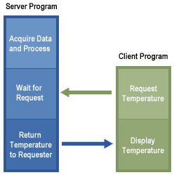
Server Application
A "server application" is an application that waits for requests from other applications and responds to them, thus providing a "service" upon their request. A web server is a server application.

Slide 26
Console
The Browser Console contains important information on Errors. While most of the errors shown are JavaScript related some server related information can get displayed as well.
CHROME:
Press either CTRL + SHIFT + J to open the “console” tab of the Developer Tools.
Alternative method:
Press either CTRL + SHIFT + I or F12 to open the Developer Tools.
Press ESC (or click on “Show console” in the bottom right corner) to slide the console up.
Note: In Chrome’s dev tools, there is a “console” tab. However, a smaller “slide-up” console can be opened while any of the other tabs is active.
SAFARI:
Press CTRL + ALT + I to open the Web Inspector.
See Chrome’s step 2. (Chrome and Safari have pretty much identical dev tools.)
Note: Step 1 only works if the “Show Develop menu in menu bar” check box in the Advanced tab of the Preferences menu is checked!

Slide 27
Console
IE9:
Press F12 to open the developer tools.
Click the “console” tab.
FIREFOX:
Press CTRL + SHIFT + K to open the Web console (COMMAND + SHIFT + K on Macs).
or, if Firebug is installed (recommended):
Press F12 to open Firebug.
Click on the “console” tab.
OPERA:
Press CTRL + SHIFT + I to open Dragonfly.
Click on the “console” tab.

Slide 28
Getting Started With JavaScript
JavaScript is a popular programming language that has a wide range of applications.
JavaScript was previously used mainly for making webpages interactive such as form validation, animation, etc. Nowadays, JavaScript is also used in many other areas such as server-side development, mobile app development and so on.
Because of its wide range of applications, you can run JavaScript in several ways:
Using console tab of web browsers
Using Node.js
By creating web pages

Slide 29
JavaScript - When Executed ?
JavaScript is versatile and beginner-friendly. With more experience, you'll be able to create games, animated 2D and 3D graphics, comprehensive database-driven apps, and much more!
JavaScript itself is relatively compact, yet very flexible. Developers have written a variety of tools on top of the core JavaScript language, unlocking a vast amount of functionality with minimum effort. These include:
Browser Application Programming Interfaces (APIs) built into web browsers, providing functionality such as dynamically creating HTML and setting CSS styles; collecting and manipulating a video stream from a user's webcam, or generating 3D graphics and audio samples.
Third-party APIs that allow developers to incorporate functionality in sites from other content providers, such as Twitter or Facebook.
Third-party frameworks and libraries that you can apply to HTML to accelerate the work of building sites and applications.

Slide 30
A Hello world! example
JavaScript is one of the most popular modern web technologies! As your JavaScript skills grow, your websites will enter a new dimension of power and creativity.
However, getting comfortable with JavaScript is more challenging than getting comfortable with HTML and CSS. You may have to start small, and progress gradually. To begin, let's examine how to add JavaScript to your page for creating a Hello world! example. (Hello world! is the standard for introductory programming examples.)
The “script” tag
JavaScript programs can be inserted almost anywhere into an HTML document using the <script> tag.

Slide 31
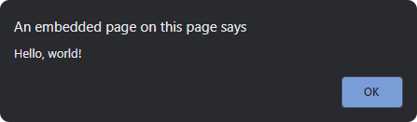
A Hello world! example
<!DOCTYPE HTML>
<html>
<body>
<p>Before the script...</p>
<script>
alert( 'Hello, world!' );
</script>
<p>...After the script.</p>
</body>
</html>

Slide 32
External Scripts
If we have a lot of JavaScript code, we can put it into a separate file.
Script files are attached to HTML with the src attribute:
<script src="/path/to/script.js"></script>
Here, /path/to/script.js is an absolute path to the script from the site root. One can also provide a relative path from the current page. For instance, src="script.js" would mean a file "script.js" in the current folder.
Please note:
As a rule, only the simplest scripts are put into HTML. More complex ones reside in separate files. The benefit of a separate file is that the browser will download it and store it in its cache. Other pages that reference the same script will take it from the cache instead of downloading it, so the file is actually downloaded only once.
That reduces traffic and makes pages faster.

Slide 33
JavaScript Syntax
Whitespace and Line Breaks
JavaScript ignores spaces, tabs, and newlines that appear in JavaScript programs. You can use spaces, tabs, and newlines freely in your program and you are free to format and indent your programs in a neat and consistent way that makes the code easy to read and understand.
Semicolons are Optional
Simple statements in JavaScript are generally followed by a semicolon character, just as they are in C, C++, and Java. JavaScript, however, allows you to omit this semicolon if each of your statements are placed on a separate line. For example, the following code could be written without semicolons.
<script language = "javascript" type = "text/javascript">
<!--
var1 = 10
var2 = 20
//-->
</script>

Slide 34
JavaScript Syntax
But when formatted in a single line as follows, you must use semicolons −
<script language = "javascript" type = "text/javascript">
<!--
var1 = 10; var2 = 20;
//-->
</script>
Note − It is a good programming practice to use semicolons.
Case Sensitivity
JavaScript is a case-sensitive language. This means that the language keywords, variables, function names, and any other identifiers must always be typed with a consistent capitalization of letters.
So the identifiers Time and TIME will convey different meanings in JavaScript.

Slide 35
JavaScript Syntax
NOTE − Care should be taken while writing variable and function names in JavaScript.
Comments in JavaScript
JavaScript supports both C-style and C++-style comments, Thus −
Any text between a // and the end of a line is treated as a comment and is ignored by JavaScript.
Any text between the characters /* and */ is treated as a comment. This may span multiple lines.
JavaScript also recognizes the HTML comment opening sequence <!--. JavaScript treats this as a single-line comment, just as it does the // comment.
The HTML comment closing sequence --> is not recognized by JavaScript so it should be written as //-->.

Slide 36
JavaScript Syntax
Example
The following example shows how to use comments in JavaScript.
<script language = "javascript" type = "text/javascript">
<!--
// This is a comment. It is similar to comments in C++
/*
* This is a multi-line comment in JavaScript
* It is very similar to comments in C Programming
*/
//-->
</script>

Slide 37
JavaScript Operators
In this tutorial, you will learn about different operators available in JavaScript and how to use them with the help of examples.
What is an Operator?
In JavaScript, an operator is a special symbol used to perform operations on operands (values and variables). For example,
2 + 3; // 5
Here + is an operator that performs addition, and 2 and 3 are operands.

Slide 38
JavaScript Operators
JavaScript Operator Types
Here is a list of different operators you will learn in this tutorial.
Assignment Operators
Arithmetic Operators
Comparison Operators
Logical Operators
Bitwise Operators
String Operators
Other Operators

Slide 39
JavaScript Operators
JavaScript Assignment Operators
Assignment operators are used to assign values to variables. For example,
const x = 5;
Here, the = operator is used to assign value 5 to variable x.
JavaScript Arithmetic Operators
Arithmetic operators are used to perform arithmetic calculations. For example,
const number = 3 + 5; // 8

Slide 40
JavaScript Operators
JavaScript Comparison Operators
Comparison operators compare two values and return a boolean value, either true or false. For example,
const a = 3, b = 2;
console.log(a > b); // true
JavaScript Logical Operators
Logical operators perform logical operations and return a boolean value, either true or false. For example,
const x = 5, y = 3;
(x < 6) && (y < 5); // true

Slide 41
JavaScript Operators
JavaScript Comparison Operators
Comparison operators compare two values and return a boolean value, either true or false. For example,
const a = 3, b = 2;
console.log(a > b); // true
JavaScript Logical Operators
Logical operators perform logical operations and return a boolean value, either true or false. For example,
const x = 5, y = 3;
(x < 6) && (y < 5); // true

Slide 42
JavaScript Operators
JavaScript Bitwise Operators
Bitwise operators perform operations on binary representations of numbers.
Operator | Description
& | Bitwise AND
| | Bitwise OR
^ | Bitwise XOR
~ | Bitwise NOT
<< | Left shift
>> | Sign-propagating right shift
>>> | Zero-fill right shift

Slide 43
JavaScript Operators
JavaScript Bitwise Operators
Bitwise operators perform operations on binary representations of numbers.
Operator | Description
& | Bitwise AND
| | Bitwise OR
^ | Bitwise XOR
~ | Bitwise NOT
<< | Left shift
>> | Sign-propagating right shift
>>> | Zero-fill right shift

Slide 44
JavaScript Operators
JavaScript String Operators
In JavaScript, you can also use the + operator to concatenate (join) two or more strings.

Slide 45
Javascript Data Types
JavaScript provides different data types to hold different types of values. There are two types of data types in JavaScript.
Primitive data type
Non-primitive (reference) data type
JavaScript is a dynamic type language, means you don't need to specify type of the variable because it is dynamically used by JavaScript engine. You need to use var here to specify the data type. It can hold any type of values such as numbers, strings etc. For example:
var a=40;//holding number
var b="Rahul";//holding string

Slide 46
Javascript Data Types
JavaScript primitive data types
There are five types of primitive data types in JavaScript. They are as follows:
Data Type | Description
String | represents sequence of characters e.g. "hello"
Number | represents numeric values e.g. 100
Boolean | represents boolean value either false or true
Undefined | represents undefined value
Null | represents null i.e. no value at all

Slide 47
Javascript Data Types
JavaScript non-primitive data types
The non-primitive data types are as follows:
Data Type | Description
Object | represents instance through which we can access members
Array | represents group of similar values
RegExp | represents regular expression

Slide 48
JavaScript Popup Boxes
JavaScript provides various popup boxes to notify, warn, or to get input from the user. Popup boxes prevent the user from accessing other aspects of a program until the popup is closed, so they should not be overused.
There are three different kinds of popup methods used in JavaScript.
Alert box
Confirm box
Prompt box
JavaScript Alert Box
An alert dialog box is mostly used to inform or alert the user by displaying some messages in a small dialogue box. Following is the syntax for it:
alert("YOUR MESSAGE COMES HERE");

Slide 49

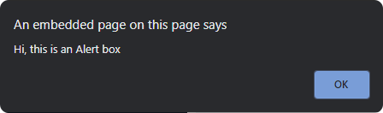
JavaScript Popup Boxes
<html>
<body>
<script>
function showAlert() {
alert("Hi, this is an Alert box");
}
</script>
<button onclick="showAlert()">Show Alert</button>
</body>
</html>

Slide 50
JavaScript Popup Boxes
JavaScript Confirm Box
A confirmation box is used to let the user make a choice. When Javascript pops up a confirm box, the user will have to click either "OK" or "Cancel" to proceed to the next step.
Also, based on what the user clicks on we can perform different actions. We can specify this course of action with conditional logic.
let result = window.confirm("SOME TEXT MESSAGE");
When the user clicks on the OK button then the result variable will get the value true and if the user clicks on the Cancel button the result variable will get the value false.
Let's take an example and see this in action:
<html>
<head>

Slide 51
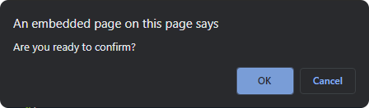

JavaScript Popup Boxes
<script type="text/javascript">
function isConfirmed() {
let conVal = confirm("Are you ready to confirm?");
if (conVal == true) {
document.getElementById("result").innerHTML = "Confirmed !";
} else {
document.getElementById("result").innerHTML = "Cancelled !";
}
}
</script>
</head>
<body>
<form>
<input type="button" onclick="isConfirmed()" value="Want to confirm ?" />
</form>
<p id="result"></p>
</body>
</html>

Slide 52
JavaScript Popup Boxes
JavaScript Prompt Box
Javascript Prompt Box can be used when we want to get some user input. When Javascript displays a prompt box, the user will see a popup box with an input field and buttons "OK" or "Cancel" to proceed after entering an input value.
Following is the syntax for the JavaScript Prompt box:
let result = prompt("SOME MESSAGE", "DEFAULT_VALUE");
Here, SOME MESSAGE is the message which is displayed in the popup box, and DEFAULT_VALUE is the default value in the input field. The default value is an optional field.
The value returned by the prompt depends on what exactly the user does with the dialog.
<html>
<head>
<script type="text/javascript">
function promptUser() {

Slide 53
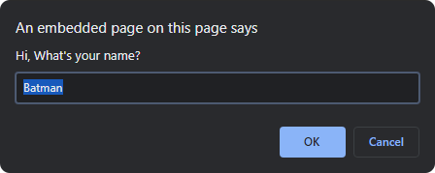

JavaScript Popup Boxes
let userInput = prompt("Hi, What's your name?", "Batman");
if(userInput != null) {
document.getElementById("result").innerHTML = "Hello " + userInput + ", good day!";
}
}
</script>
</head>
<body>
<button onclick="promptUser()">Click on me!</button>
<p id="result"></p>
</body>
</html>

Slide 54
JavaScript if, else and else if Statements
In JavaScript, to control the flow of your program or script based on conditions, we can use the if...else conditional statements. The if and else conditional statement works just like they are used in real world while communicating. For example, see the following statement, if you score more than 40% marks you will pass the exam else you will fail in the exam, here the condition is score more than 40%, if it's true then you pass, if it is false then you fail.
In JavaScript, if is a conditional statement that is used to control the program flow just like in C, C++, etc programming languages. It is one of the most basic and simplest way to control the flow of program based on conditions. You can use the if statement when we want to execute code statements only when a particular condition is true.
The condition for the if statement is enclosed within the parenthesis immediately after the if keyword.
JavaScript if: Syntax and Use
Below we have the basic syntax for using the if statement in the JavaScript code.
if(<EXPRESSION>)
{
// block of statements
}

Slide 55
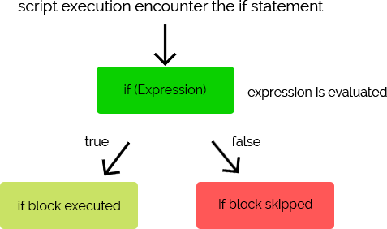
JavaScript if, else and else if Statements
The condition passed with the if statement is mostly an expression that can have comparison of two values, any expression returning boolean output true/false, or any other expression. Also, the condition will be satisfied when the expression returns true or any positive numeric value, and in that case, the block of code statements enclosed within the curly braces below the if statement will be executed.

Slide 56

JavaScript if, else and else if Statements
<html>
<body>
<script>
let a = 2;
if(a <= 5)
{
document.write("if statement executed");
}
</script>
</body>
</html>

Slide 57
JavaScript if, else and else if Statements
JavaScript if...else: Syntax and Use
JavaScript if statement lets you to create a code block with a condition and if the specified condition is true then code statements written inside the if block will get executed. The else statement also creates a code block that is only executed when the specified condition in the if statement is false.
if(<EXPRESSION>)
{
// if block
}
else
{
// else block
}
The else statement is always used along with the if statement right after the if block. We cannot provide a condition/expression with the else statement like we do with the if statement.

Slide 58

JavaScript if, else and else if Statements

Slide 59
JavaScript if, else and else if Statements
<html>
<body>
<script>
let a = 8;
if(a <= 5) {
document.write("if block executed");
}
else
{
document.write("else block executed");
}
</script>
</body>
</html>

Slide 60
JavaScript if, else and else if Statements
JavaScript if…else if: Syntax and Use
JavaScript else if statement is used along with the if statement to define multiple different conditions and code blocks. When we have to implement multiple conditions in our script then we can use the if, else if and else statements in our code. The else if statement is used between the if and else statement, where else is not mandatory.
Below we have the basic syntax of using else if along with if and else statements.
if(EXPRESSION1)
{
// if block
}
else if(EXPRESSION2)
{
// else if block
}
else if(EXPRESSION3)
{
// another else if block
}
else
{
// else block
}

Slide 61
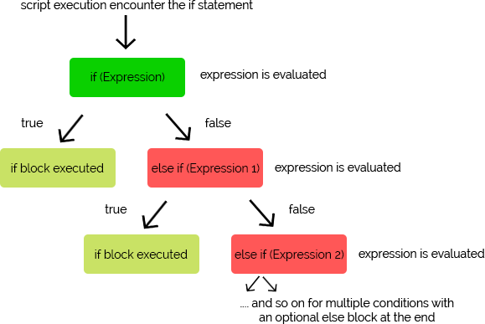
JavaScript if, else and else if Statements
We can have as many else if block as we want after the if statement. Also, having an else block at the end is optional.

Slide 62
JavaScript if, else and else if Statements
<html>
<body>
<script>
let a = 8;
if(a < 8)
{
document.write("Number is less than 8");
}
else if (a = 8)
{
document.write("Number is equal to 8");
}

Slide 63
JavaScript if, else and else if Statements
else {
document.write("Number is greater than 8");
}
</script>
</body>
</html>

Slide 64
JavaScript for Loop
JavaScript for Loop is used to execute a particular code block multiple times until a given condition holds true or until all the elements of a given JavaScript object like Array or List are completely traversed.
There are times when we would want to perform a certain operation a certain number of times, like if we have a list of employees with their salaries and we have to calculate their income tax. Now the formula for getting the income tax is the same for all employees, so we can have a loop and execute the code statements with different inputs.
Similarly, for a use case like printing the mathematical table of a number like 2, we can simply have a loop in place to keep on multiplying the number with 1, 2, 3, 4, and so on till 10, incrementing the multiplication factor every time.
The number of times a group of statements is executed depends on a condition provided in the loop, or if we are using the for loop to traverse an array, list, etc, then the loop executes until complete traversal.
The loop statements are executed until the condition becomes false. When the condition becomes false, the execution of loop stops.

Slide 65
JavaScript for Loop
In JavaScript, there are various types of loops.
for loop
while loop
do-while loop

Slide 66
JavaScript for Loop
JavaScript for Loop
If you want to execute statements for a specific number of times then you can use the JavaScript for loop, which lets you iterate the statements for a fixed number of times.
The for loop consists of three statements to work:
initialization: here, the loop counter is initialized with its initial value.
condition: here, the condition statement is provided which is checked each time with respect to the value of the counter to continue the iteration.
iteration: this statement lets you decide whether you want to increase or decrease the initial counter value also known as increment/decrement.
Following is the syntax for the for loop:
for(initialization; condition; iteration)
{
// statements
}

Slide 67
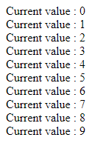
JavaScript for Loop
The idea here is to initialize a counter, set a condition until which the loop will run, and keep on incrementing or decrementing the counter so that after certain iteration the condition fails, and the loop exits. If the condition never fails, the loop will keep on executing infinitely.
<html>
<body>
<script>
// for loop example
for(let a = 0; a < 10; a++) {
document.write("Current value : " + a);
document.write("<br />");
}
</script>
</body>
</html>
Output:

Slide 68
JavaScript for Loop
break
The break statement terminates the current loop, switch, or label statement and transfers program control to the statement following the terminated statement.
The break statement includes an optional label that allows the program to break out of a labeled statement. The break statement needs to be nested within the referenced label. The labeled statement can be any block statement; it does not have to be preceded by a loop statement.
A break statement, with or without a following label, cannot be used within the body of a function that is itself nested within the current loop, switch, or label statement that the break statement is intended to break out of.
let i = 0;
while (i < 6) {
if (i === 3) {
break;
}
i = i + 1;
}
console.log(i);
// expected output: 3
Output:
> 3

Slide 69
JavaScript while Loop and do-while Loop
Whenever you want to execute a certain statement over and over again you can use the JavaScript while loop to ease up your work. JavaScript while loop lets us iterate the code block as long as the specified condition is true. Just like for Loop, the while and do...while loop are also used to execute code statements multiple times based on a condition.
The only difference between the while loop and do...while loop is that the do...while loop will execute at least once because in do...while loop the condition is checked after execution of code block.
JavaScript while Loop: Syntax and Use
Below is the syntax for the while loop:
while(condition)
{
// code statements
}

Slide 70
JavaScript while Loop and do-while Loop
In this example, we are using while loop, and the loop executes only if the specified condition is true.
<html>
<head>
<script>
let a = 9;
// while loop will be executed two times
while (a <= 10)
{
document.write("while executed <br/>");
a++;
}
</script>
</head>
<body>
</body>
</html>
Output :
while executed
while executed

Slide 71
JavaScript while Loop and do-while Loop
JavaScript do…while Loop: Syntax and Use
Just like the while loop, the do...while loop lets you iterate the code block as long as the specified condition is true. In the do-while loop, the condition is checked after executing the loop. So, even if the condition is true or false, the code block will be executed for at least one time.
Below we have the syntax of the do...while loop,
do
{
// code statements
}
while(condition)

Slide 72
JavaScript while Loop and do-while Loop
Let's take an example and see the do...while loop in action.
<html>
<body>
<script>
let a = 10;
// will execute twice
do
{
document.write("do executed <br/>");
a++;
}
while(a < 12)
</script>
</body>
</html>
Output:
do executed
do executed

Slide 73
JavaScript while Loop and do-while Loop
Let's take an example and see the do...while loop in action.
<html>
<body>
<script>
let a = 10;
// will execute twice
do
{
document.write("do executed <br/>");
a++;
}
while(a < 12)
</script>
</body>
</html>
Output:
do executed
do executed

Slide 74
JavaScript Switch case
JavaScript Switch case is used to execute a block of statement out of multiple blocks of statements based on a condition. JavaScript switch is a condition-based statement that has multiple conditions but executes only one block at a time.
In switch statement, the switch expression is evaluated only once and then the output is compared with every case mentioned inside the switch block and if the output of expression matches one of the cases then the statement written inside the block of that case is executed. If no case matches then the default case is executed.
JavaScript switch case is used in applications where you have to implement a menu like system in which based on user input certain action is taken.
JavaScript switch: Syntax
The expression which evaluates the condition is written inside the switch(expression), followed by a curly bracket which creates a switch block in which the different cases are defined.

Slide 75
JavaScript Switch case
switch(expression)
{
case 1:
//code
break;
case 2:
//code
break;
default:
}
Based on the value of the expression's output, one of the many cases gets executed, and then the break statement is called which breaks the execution, and the switch case gets exited.
NOTE: If we do not add the break statement after the code statements in the switch case block, then the interpreter would execute each and every case after the matched case.

Slide 76
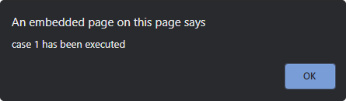
JavaScript Switch case
In this example, we are using the switch case and each case executes based on the provided value.
<html>
<head>
<script>
let a = 1;
switch (a)
{
case 1: alert('case 1 has been executed');
break;
case 2:
alert("case 2 has been executed");
break;
case 3:
alert("case 3 has been executed");
break;
case 4:
alert("case 4 has been executed");
break;
default:
alert("default case executed");
}
</script>
</head>
<body>
<!-- HTML body -->
</body>
</html>
We have used the break statement to terminate the switch case.

Slide 77
document.write()
When the document is being read and parsed by the browser, if there's a script element that calls document.write, the output of document.write is inserted into the document at that point. Later, though, once the page is fully loaded, if you use document.write, it implicitly performs a document.open, which wipes out the page and starts writing a new one from scratch.
Note: Because document.write() writes to the document stream, calling document.write() on a closed (loaded) document automatically calls document.open()
<html>
<head>
<title>Write example</title>
<script>
function newContent() {
document.open();

Slide 78
document.write()
document.write("<h1>Hello, World is common</h1>");
document.close();
}
</script>
</head>
<body onload="newContent();">
<p>Some original document content.</p>
</body>
</html>
Output:
Hello World is common

Slide 79
JavaScript Functions
JavaScript Functions, just like in any other language, is a set of statements that are used to perform a specific task, like adding two numbers, finding the square of a number, or any user-defined task.
Let's take an example to understand the concept of Functions.
If you are building an application for Student Management in which you take data from a student during the registration process and then that data is used at the time of identity card printing, mark sheet printing, any notice printing or anywhere else, then one approach would be that wherever you want student data you can use the student id, query the database and find all the information about the student. You will have to write the same code wherever you want student information. But this will lead to code repetition and if you have to change something in this logic of fetching student data, you will have to make the changes everywhere.

Slide 80
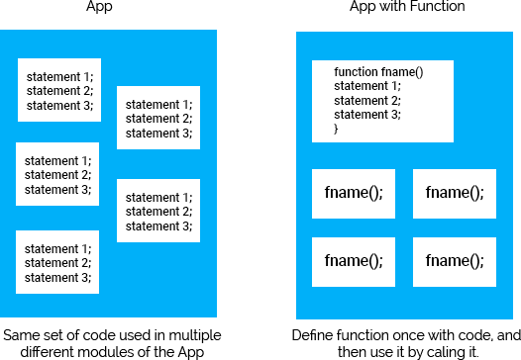
JavaScript Functions
The better approach to this problem would be defining a function, which takes student id as input, queries the database and returns the student data as output, and then use this function anywhere we want by just calling it. Now, if you have to change something in the logic, you can do it easily.

Slide 81
JavaScript Functions
JavaScript Function: Definition
Now that you have an idea, what a function is, let's see its definition, and how we can define a function, the basic function structure, and using a function in JavaScript.
JavaScript function is a set of statements that are used to perform a specific task. It can take one or more input and can return output as well. Both, taking input and returning an output are optional.
Using functions avoids repetition of the code as we need to write the code only once and then the code can be called anywhere using function name. A function can be helpful in the following scenarios.
For instance, suppose you want to add some numbers and display the results on a web page. In that case, you can define the code for adding the numbers in a function and call the function whenever needed.
For repetitive tasks like displaying a message whenever a web page is loaded into the browser, we can use functions.

Slide 82
Why functions are required ?
Every function in JavaScript is a Function object. See Function for information on properties and methods of Function objects.
To return a value other than the default, a function must have a return statement that specifies the value to return. A function without a return statement will return a default value. In the case of a constructor called with the new keyword, the default value is the value of its this parameter. For all other functions, the default return value is undefined.
The parameters of a function call are the function's arguments. Arguments are passed to functions by value. If the function changes the value of an argument, this change is not reflected globally or in the calling function. However, object references are values, too, and they are special: if the function changes the referred object's properties, that change is visible outside the function,

Slide 83
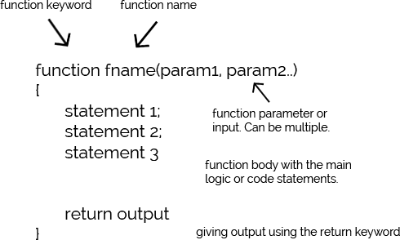
JavaScript Functions
Following image shows the structure of a JavaScript function:

Slide 84
JavaScript Functions
As already mentioned, functions can be parameterized and non-parameterized which means they may or may not take any input. A function that does not take any parameters/inputs is known as non-parameterized function.
A function that takes parameters/inputs which must be defined within parenthesis with the function name(before function definition), is known as a parameterized function. When we call a function, we can provide custom values for these parameters which are then used in function definition.
To return output from a function, we use the return statement.
Broadly, we can categorize functions into two category:
User defined Function
Built-in Function
We mostly focus on the user defined functions because built-in functions are JavaScript library functions which we can call anytime in our script to use them.

Slide 85
JavaScript Functions
JavaScript User-defined Function
JavaScript allows us to define our own functions as per our requirement, as we discussed above. Let's understand how to create our own functions and call them in our script to use them.
Creating a User-defined Function:
In JavaScript, function is defined by using the function keyword followed by the function name and parentheses ( ), to hold params(inputs) if any. A function can have zero or more parameters separated by commas.
The function body is enclosed within curly braces just after the function declaration part(function name and params), and at the end of the function body, we can have a return statement to return some output, if we want.
Following is the syntax for JavaScript user-defined functions:
function function_name(parameter-1, parameter-2,...parameter-n)

Slide 86
JavaScript Functions
{
// function body
}
where, function_name represents the name of the function and parameter-1, ... , parameter-n represents list of parameters.
Calling a User-defined Function:
After creating a function, we can call it anywhere in our script. The syntax for calling a function is given below:
function_name(val-1, val-2, ..., val-n);
Here, list of parameters represents the values passed to the function during function call, which the function has specified in function definition. If a function does not take any parameters then we don't have to provide any value while calling the function.

Slide 87
JavaScript Functions
User-defined Function return Statement:
A function may or may not have a return statement, because not all functions return an output. A return statement is used to specify the value/result/output that is returned from a function.
It's completely optional to have a return statement in your function definition. The execution of a return statement is the final act of a function, after the execution of the return statement, control of execution passes back to the calling statement, which means the control of execution exits the function.
Following is the syntax for using the return statement:
return value;
The return keyword returns the value to the calling statement.

Slide 88
JavaScript Functions
Example:
<html>
<head>
<script>
function mySumFunction(a, b)
{
// return the result
return a+b;
}
let x = myFunction(8, 7);
alert(x);
</script>
</head>
</html>

Slide 89
Additional
1. What is just in time compilation ? Just-in-time compilation is a technique for improving the performance of interpreted programs. In the time of execution,the program may be compiled into native code to improve its performance. It is also known as dynamic compilation.
2. What is platform in platform independence ?
The platform is a hardware or software used to run an application. The term Platform Independence means "write once and run anywhere". We have different types of operating systems like mac,windows,linux etc. The meaning of platform independent is that, the java source code can run on all operating systems like windows,linux etc.
3. What is DOM ?
The Document Object Model is a cross-platform and language-independent interface that treats an XML or HTML document as a tree structure wherein each node is an object representing a part of the document. The DOM represents a document with a logical tree. The Document interface represents any web page loaded in the browser and serves as an entry point into the web page's content, which is the DOM tree.

Slide 90
Additional
4. What is 32-bit bitwise operands
The operands are converted to 32-bit integers and expressed by a series of bits (zeroes and ones). Numbers with more than 32 bits get their most significant bits discarded. For example, the following integer with more than 32 bits will be converted to a 32 bit integer:
Before: 11100110111110100000000000000110000000000001
After: 10100000000000000110000000000001
5 . What is bitwise ?
In computer programming, a bitwise operation operates on a bit string, a bit array or a binary numeral at the level of its individual bits. It is a fast and simple action, basic to the higher level arithmetic operations and directly supported by the processor.

Slide 91
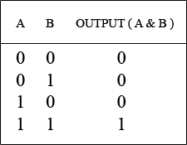
Additional
6. What is bitwise AND and similar operators
Bit-wise AND ( & ) : It is a binary operator i.e. accepts two operands. Bit-wise AND (&) returns 1 if both the bits are set ( i.e 1) and 0 in any other case.

Slide 92
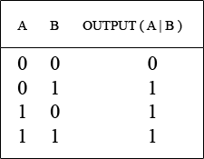
Additional
Bit-Wise OR ( | ) : Its is a binary operator i.e. accepts two operands. Bit-wise OR ( | ) returns 1 if any of the operand is set (i.e. 1) and 0 in any other case.

Slide 93
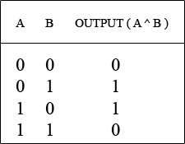
Additional
Bit-Wise XOR ( ^ ) : Its is a binary operator i.e. accepts two operands. Bit-wise XOR ( ^ ) returns 1 if both the operands are different and 0 in any other case.

Slide 94
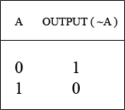
Additional
Bit-Wise NOT ( ~ ) : Its is a unary operator i.e. accepts single operands. Bit-wise NOT ( ~ ) flips the bits i.e 0 becomes 1 and 1 becomes 0.

Slide 95
Assignment
Write a JavaScript that outputs the string "Hello, World!" into a web page.
Create a web page that calculates how old you are and displays the result.
Embed JavaScript code in an HTML file.
Call an external JavaScript file in a HTML document.
Insert JavaScript code inside HTML tag.
Insert JavaScript Single line comments.
Insert JavaScript Multi line comments.
Create variables in JavaScript.
Declare variables in JavaScript.
Show Alert, Confirm and Prompt Box in Javascript.
Get the length of a string
<p>This is a demo content</p>. Change this content to “Hello World” using JavaScript.
Click on a button to open a Modal Popup, close the popup when clicked outside.
Apply mouseover event on a square shape from circle shape and give x axis animated movement.

Slide 96
Summary
With this, we come to the end of our JavaScript Tutorial. Now we can say that we are familiar with the term JavaScript. It allows us to dynamically create and manipulate content and multimedia for the web. JavaScript helps in supporting and creating some of the best applications that we use worldwide. Suffice it to say, it’s a great language for both beginners, as well as the experts.
Hope the information provided was helpful for you!

Slide 97
Thank You

